Slide 1
Part 2.6: Using Character Tables

Slide 2

Using Character Tables
Basis Functions
Representations
  Reducible
  Irreducible
Red. to Irr. Reps
Examples
  N₂H₂
  XeOF₄
Direct Products
Point Group?

Slide 3
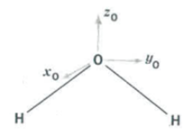
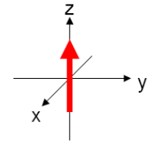
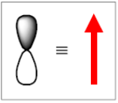
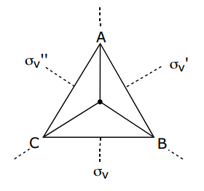
Basis Functions
How does (basis) behave under the operations of (point group)?
For molecules/materials:
atoms
cartisian coordinates
orbitals
rotation direction
bonds
angles
displacement vectors
plane waves
C₃

Slide 4
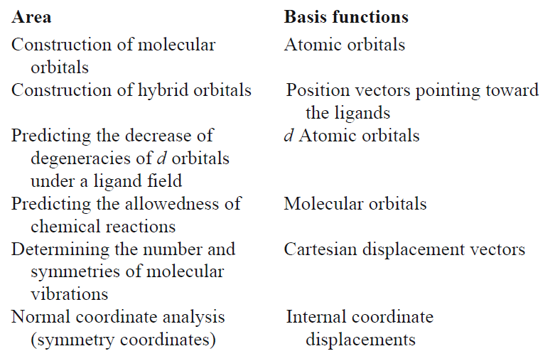
Basis Functions

Slide 5
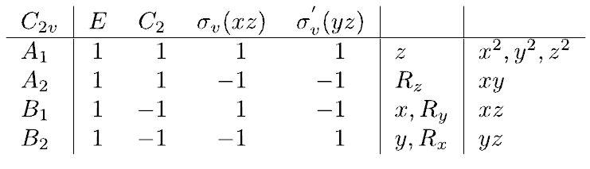
Representations (Γ)
Reducible Representation-
A representation of a symmetry operation of a group, which CAN be expressed in terms of a representation of lower dimension.
CAN be broken down into a simpler form.
Characters CAN be further diagonalized.
Are composed of several irreducible representations.
Irreducible Representation-
A representation of a symmetry operation of a group, which CANNOT be expressed in terms of a representation of lower dimension.
CANNOT be broken down into a simpler form.
Characters CANNOT be further diagonalized.

Slide 6
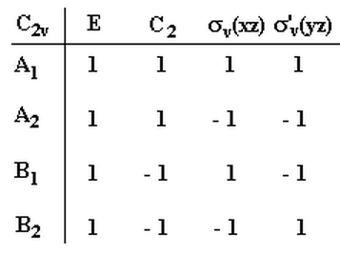
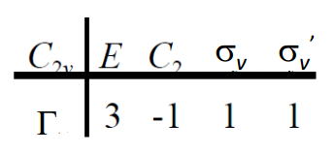

Representations (Γ)
composed of several irreducible representations.
Reducible Representation
Irreducible Representations

Slide 7
Representations (Γ)
Reducible to Irreducible Representations
Reducible Rep.
Irreducible Rep.
A lot of algebra
Inspection/Trial and Error
Decomposition/Reduction Formula

Slide 8
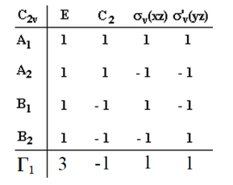
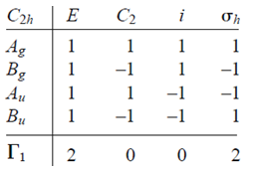
Representations (Γ)
2) Inspection/Trial and Error
Reducible Rep.
Reducible Rep.
Γ₁ = A_{g} + B_{u}
Γ₁ = A₁ + B₁ + B₂
Irreducible Reps.
Irreducible Reps.

Slide 9
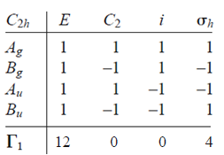
Representations (Γ)
2) Inspection/Trial and Error
Reducible Rep.
4A_{g} + 2B_{g} + 2A_{u} + 4B_{u}
Γ₁ =
Irreducible Reps.

Slide 10
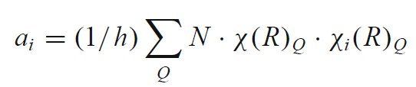
Representations (Γ)
3) Decomposition/Reduction Formula
a_{i} is the number of times the irreducible rep. appears in Γ₁
h is the order of the group
N is the number of operations in class Q
χ(R)_{Q} is the character of the reducible representation
χ_{i}(R)_{Q} is the character of the irreducible representation
Cannot be applied to D_{∞h} and C_{∞h}

Slide 11
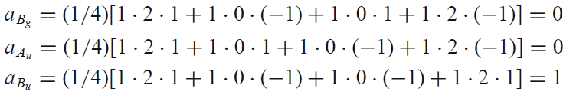
Representations (Γ)
3) Decomposition/Reduction Formula
order (h)
h = 1 + 1 + 1 + 1 = 4
Γ₁ = A_{g} + B_{u}
1
[
]
4
a_{Ag} =
(1)(2)(1)
+ (1)(0)(1) + (1)(0)(1) + (1)(2)(1)
=
= 1
4
4

Slide 12
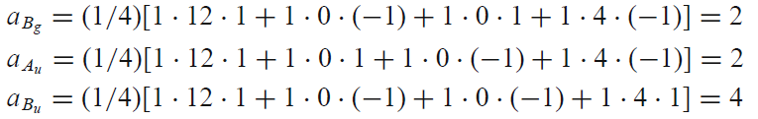
Representations (Γ)
3) Decomposition/Reduction Formula
order (h)
h = 1 + 1 + 1 + 1 = 4
4A_{g} + 2B_{g} + 2A_{u} + 4B_{u}
Γ₁ =

Slide 13
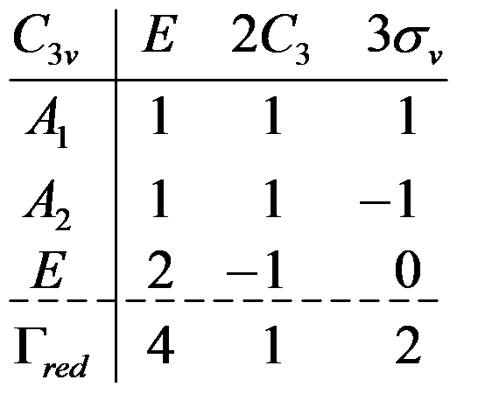
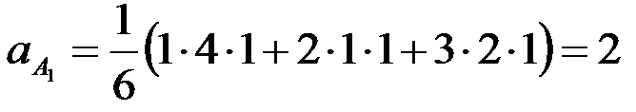
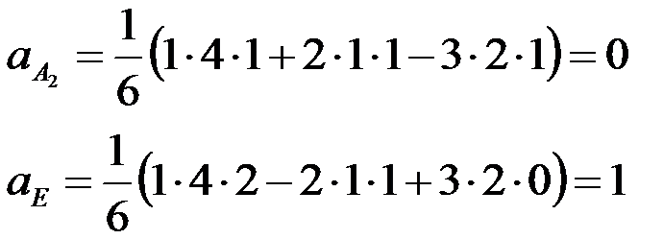
Representations (Γ)
3) Decomposition/Reduction Formula
order (h)
h = 1 + 2 + 3 = 6
Γ_{red} = 2A₁ + E

Slide 14

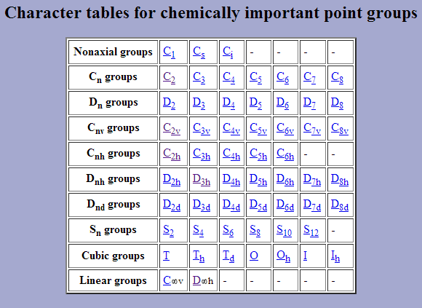
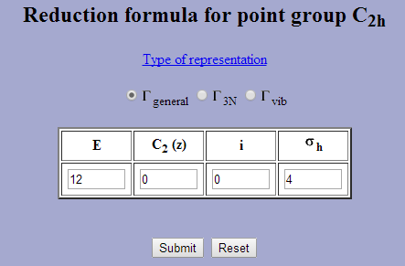
Or there is a website/spreadsheet
http://symmetry.jacobs-university.de/

Slide 15
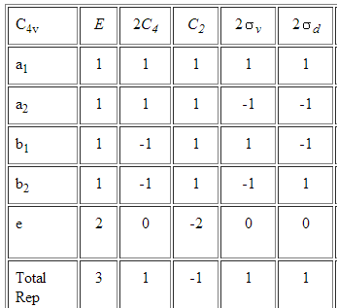
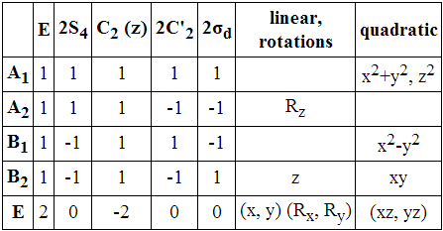
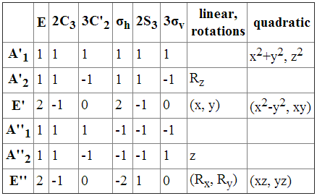
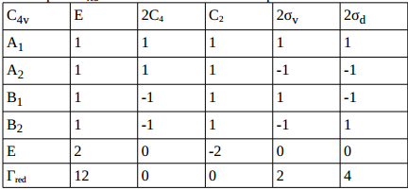
Practice Irreducible Rep
Γ₁
6 0 2 2 2
Γ₂
6 4 6 2 0
Γ₁
3 0 -1 -3 0 1

Slide 16
Basis to Red. Rep to Irr. Rep.
Assign a point group
Choose basis function (bond, vibration, orbital, angle, etc.)
Apply operations
  -if the basis stays the same = +1
  -if the basis is reversed = -1
  -if it is a more complicated change = 0
Generate a reducible representation
Reduce to Irreducible Representation
  No matrix math is necessary!

Slide 17
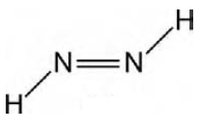


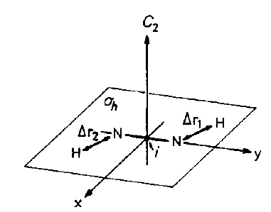




Example: N₂H₂
Assign a point group
Choose basis function
Apply operations
  -if the basis stays the same = +1
  -if the basis is reversed = -1
  -if it is a more complicated change = 0
C_{2h}
N-H bond length (Δr)
E: 1 + 1 = 2
C₂: 0 + 0 = 0
i: 0 + 0 = 0
σ_{h}: 1 + 1 = 2
C_{2h} operations: E, C₂, i, σ_{h}

Slide 18

Example: N₂H₂
Assign a point group
Choose basis function
Apply operations
  -if the basis stays the same = +1
  -if the basis is reversed = -1
  -if it is a more complicated change = 0
Generate a reducible representation
C_{2h}
N-H bond length (Δr)
E: 1 + 1 = 2
C₂: 0 + 0 = 0
Γ
2
0
0
2
i: 0 + 0 = 0
σ_{h}: 1 + 1 = 2

Slide 19
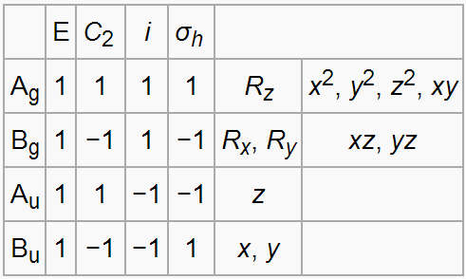
Example: N₂H₂
Assign a point group
Choose basis function
Apply operations
  -if the basis stays the same = +1
  -if the basis is reversed = -1
  -if it is a more complicated change = 0
Generate a reducible representation
Reduce to Irreducible Representation
C_{2h}
N-H bond length (Δr)
Γ
2
0
0
2
Reducible Rep.
Irreducible Rep.

Slide 20
Example: N₂H₂
Decomposition/Reduction Formula
order (h)
h = 1 + 1 + 1 + 1 = 4
Γ₁ = A_{g} + B_{u}
1
[
]
4
a_{Ag} =
(1)(2)(1)
+ (1)(0)(1) + (1)(0)(1) + (1)(2)(1)
=
= 1
4
4

Slide 21
Example: N₂H₂
Assign a point group
Choose basis function
Apply operations
  -if the basis stays the same = +1
  -if the basis is reversed = -1
  -if it is a more complicated change = 0
Generate a reducible representation
Reduce to Irreducible Representation
C_{2h}
N-H bond length (Δr)
Γ₁ = A_{g} + B_{u}
The symmetric aspects of Δr₁ and Δr₂ can be described by A_{g} and B_{u} irreducible representations.

Slide 22
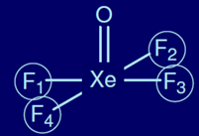
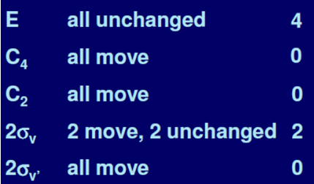
Example: XeOF₄
Assign a point group
Choose basis function
Apply operations
  -if the basis stays the same = +1
  -if the basis is reversed = -1
  -if it is a more complicated change = 0
C_{4v}
F atoms
C_{4v} operations: E, C₄, C₂, σ_{v} , σ_{v}’

Slide 23
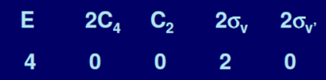
Example: XeOF₄
Assign a point group
Choose basis function
Apply operations
  -if the basis stays the same = +1
  -if the basis is reversed = -1
  -if it is a more complicated change = 0
Generate a reducible representation
C_{4v} point group
F atoms
Γ

Slide 24
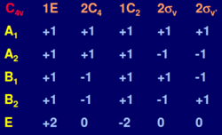
Example: XeOF₄
Assign a point group
Choose basis function
Apply operations
  -if the basis stays the same = +1
  -if the basis is reversed = -1
  -if it is a more complicated change = 0
Generate a reducible representation
Reduce to Irreducible Representation
C_{4v} point group
F atoms
Γ
Reducible Rep.
Irreducible Rep.

Slide 25
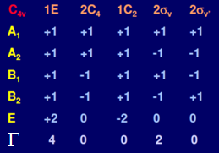
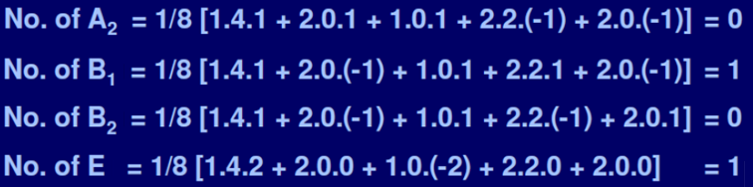
Example: XeOF₄
Decomposition/Reduction Formula
order (h)
h = 1 + 2 + 1 + 2 + 2 = 8
Γ = A₁ + B₁ + E
1
8
[
]
(1)(4)(1)
+ (2)(0)(1) + (1)(0)(1) + (2)(2)(1) + (2)(0)(1)
= 1
a_{A1} =
=
8
8

Slide 26
Example: XeOF₄
Assign a point group
Choose basis function
Apply operations
  -if the basis stays the same = +1
  -if the basis is reversed = -1
  -if it is a more complicated change = 0
Generate a reducible representation
Reduce to Irreducible Representation
C_{4v} point group
F atoms
Γ = A₁ + B₁ + E
The symmetric aspects of F atoms can be described by A₁, B₁ and E irreducible representations.

Slide 27
Using Character Tables
Basis Functions
Representations
  Reducible
  Irreducible
Red. to Irr. Reps
Examples
  N₂H₂
  XeOF₄
Direct Products
Point Group?

Slide 28
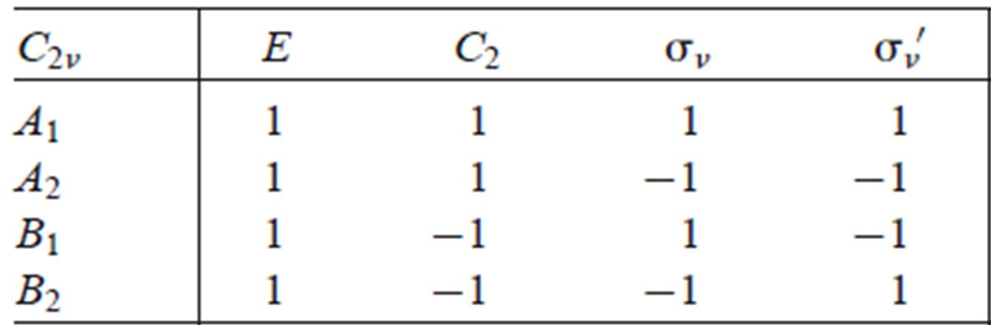





Direct Products
Direct product: The representation of the product of two representations is given by the product of the characters of the two representations.

Slide 29
Direct Products
Direct product: The representation of the product of two representations is given by the product of the characters of the two representations.
Used to determine the:
- representation for a wave function
- ground and excited state symmetry
- allowedness of a reaction
-determining the symmetry of many electron states
- allowedness of a vibronic transition
- allowedness of a electronic transition

Slide 30
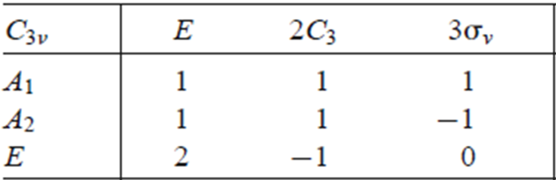

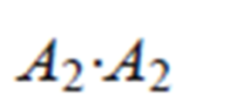





Direct Products
Direct product: The representation of the product of two representations is given by the product of the characters of the two representations.
The direct product of two irreducible representations will be a new representation which is either an irreducible or a reducible representations.

Slide 31
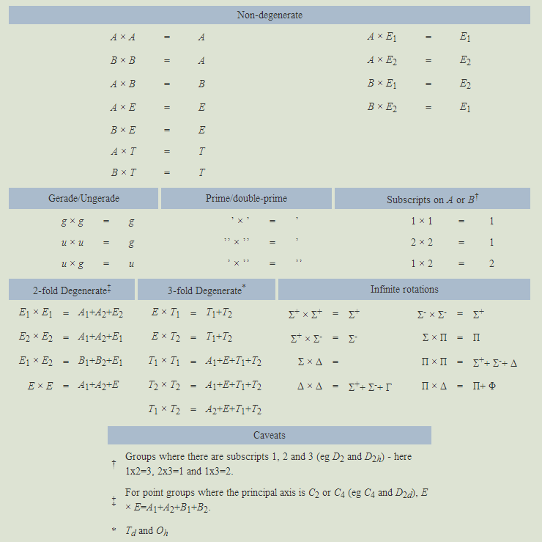
Direct Product General Rules
The product of any singly degenerate representation with itself is a totally symmetric representation
The product of any representation with the totally symmetric representation is totally symmetric representation
Totally symmetric representation =
A, A₁, A_{g}, A_{1g}, etc.

Slide 32
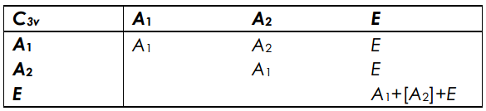
Direct Product Tables

Slide 33
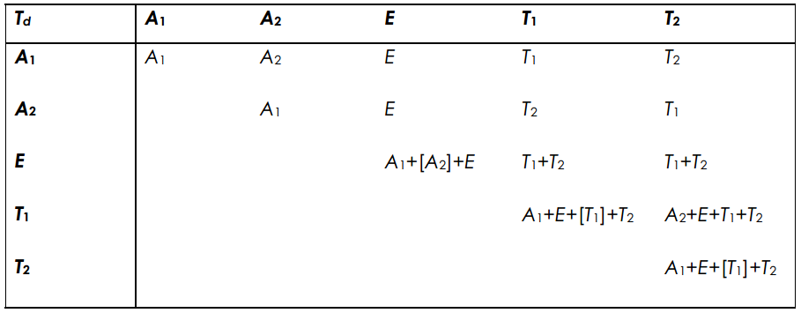
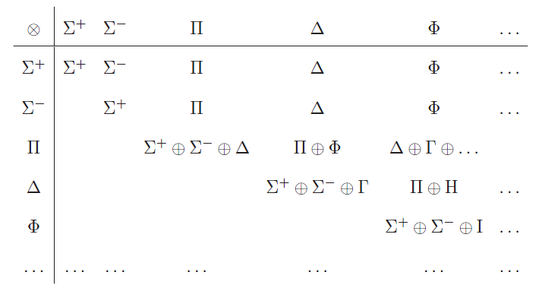
Direct Product Tables
D∞h

Slide 34
Direct Products
Direct product: The representation of the product of two representations is given by the product of the characters of the two representations.
Used to determine the:
- representation for a wave function
- ground and excited state symmetry
- allowedness of a reaction
-determining the symmetry of many electron states
- allowedness of a vibronic transition
- allowedness of a electronic transition

Slide 35
Using Character Tables
Basis Functions
Representations
  Reducible
  Irreducible
Red. to Irr. Reps
Examples
  N₂H₂
  XeOF₄
Direct Products
Point Group?

